Slide 1
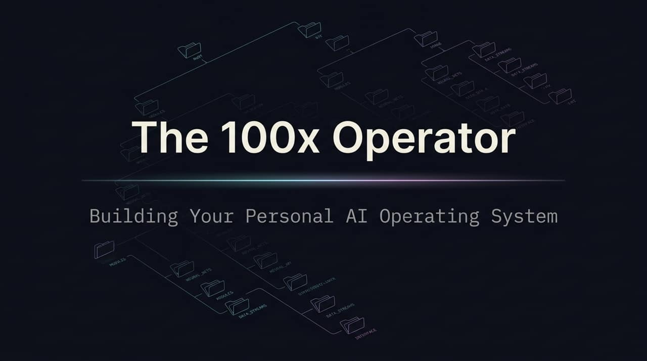
Notes:
https://www.youtube.com/watch?v=5p-sq8v3OXw
Welcome, everyone. Today, we’re stepping out of the early era of artificial intelligence and into the future of operational leverage. Most people are still using AI like a glorified search bar or typing prompts to get quick text snippets. But today, we are going to talk about how to build your Personal AI Operating System.
My goal for you today is simple: by the end of this presentation, you will understand how to transform AI from a casual chat companion into an autonomous, end-to-end digital workforce. We are moving away from spending hours copying and pasting prompts to becoming an orchestrator of systems—what I call the 100x Operator. Let’s dive in.

Slide 2
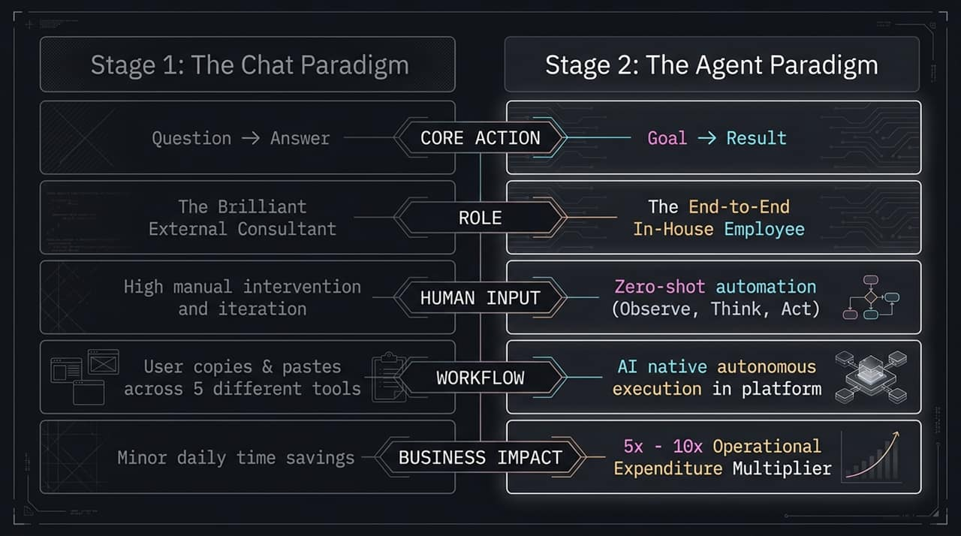
Notes:
To understand where we are going, we first need to look at where AI usage currently sits.
Stage 1 is the Chat Paradigm. Think ChatGPT or Claude Chat in a standard browser. It operates on a Question $\rightarrow$ Answer model. In this stage, AI acts as a brilliant external consultant. You ask a question, it gives you advice, but you have to do all the heavy lifting. You copy text from ChatGPT, paste it into an email, jump into Notion, manually upload assets, and switch between 5 different tools. The result? Minor daily time savings, but high friction and context switching.
Stage 2 is the Agent Paradigm. Here, the core mechanism shifts from Question $\rightarrow$ Answer to Goal $\rightarrow$ Result. Instead of an external consultant, the agent acts like an end-to-end in-house employee. You give it a high-level goal—for example, 'Launch our holiday promo campaign'—and through zero-shot automation, it observes, thinks, and acts natively across your platforms. This is where companies and individuals unlock a 5x to 10x Operational Expenditure Multiplier.

Slide 3
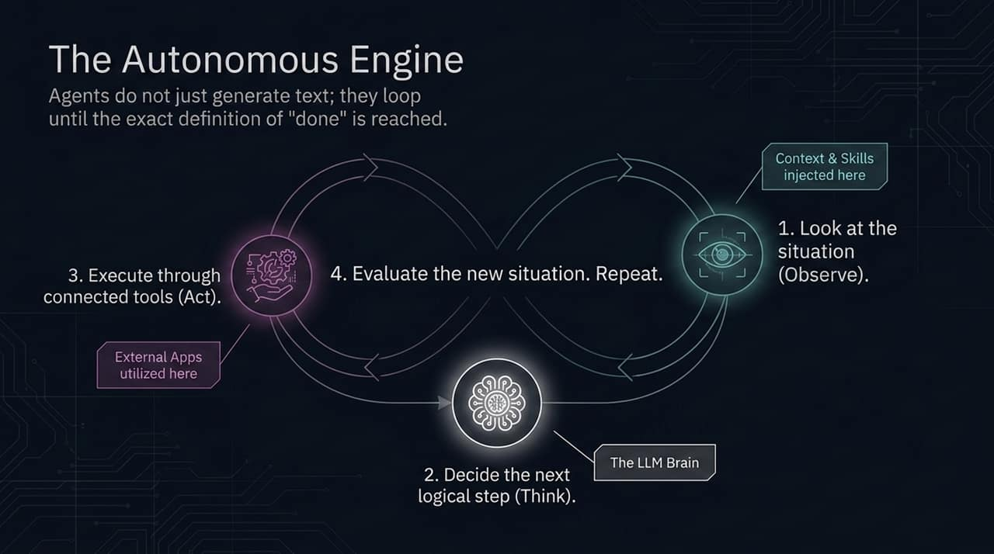
Notes:
How does an AI agent actually work under the hood without getting stuck? It runs on an iterative loop: Observe, Think, Act.
Observe: The agent scans the current environment. It looks at the files in your project, reads recent emails, or checks API responses.
Think: Using the Large Language Model brain, it determines the next single logical step required to get closer to the final goal.
Act: It executes that action using connected external tools—whether that's drafting an email, updating a database, or pulling web analytics.
The magic of an agent is that it doesn't stop after generating one piece of text. It evaluates the new situation after taking an action and repeats this loop continuously until the exact definition of 'done' is achieved. An agent can run quietly in the background for 20 minutes, performing dozens of sequential micro-tasks, and only ping you when the final deliverable is ready.

Slide 4
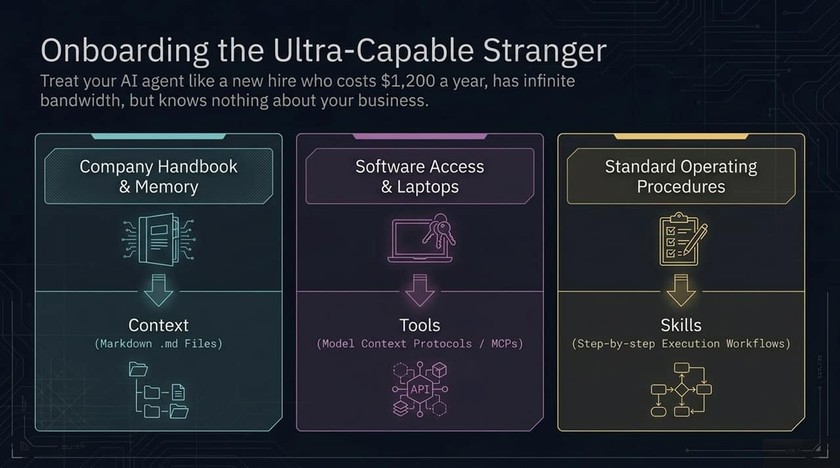
Notes:
When you open a brand-new AI agent out of the box, it is super-intelligent, but it suffers from severe 'business amnesia'. The mental model you should use is: Treat setting up an AI agent like onboarding a highly capable new employee.
Imagine hiring a top-tier executive assistant for $1,200 a year who has infinite bandwidth, but knows absolutely nothing about your company culture, products, or guidelines. You wouldn't just tell them 'run my marketing' on day one without training them. You would give them three key things:
Context: The company handbooks and brand documentation (stored as Markdown .md files).
Tools: Software access, credentials, and API connections (Model Context Protocols / MCPs).
Skills: Your Standard Operating Procedures (SOPs) detailing step-by-step execution workflows.

Slide 5
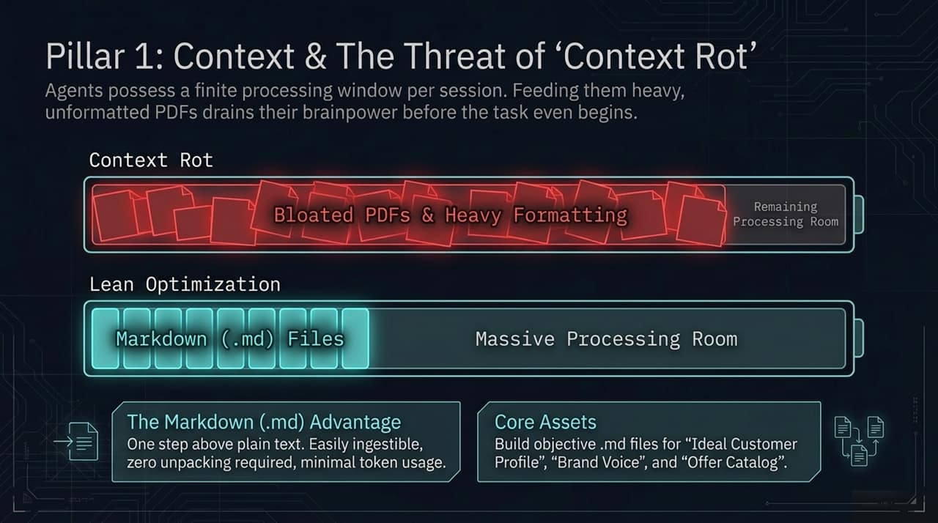
Notes:
Let me introduce you to the first pillar: Context, and a critical issue called Context Rot.
Every AI agent session has a finite processing window—often called its context window. A common mistake is uploading bloated 50-page PDFs or heavily formatted Word documents. The LLM spends a massive portion of its processing energy just parsing headers, formatting, and useless visual noise, leaving very little room for actual reasoning. This degrades the AI's intelligence mid-task.
The solution is Lean Optimization using Markdown (.md) files. Markdown is clean, plain-text structured data. It requires zero unpacking and consumes minimal token space, leaving a massive processing runway for the AI brain. Your core company assets—like your Ideal Customer Profile (ICP.md), Brand Voice (brand_voice.md), and Offer Catalog (offers.md)—should all live as concise Markdown files.

Slide 6
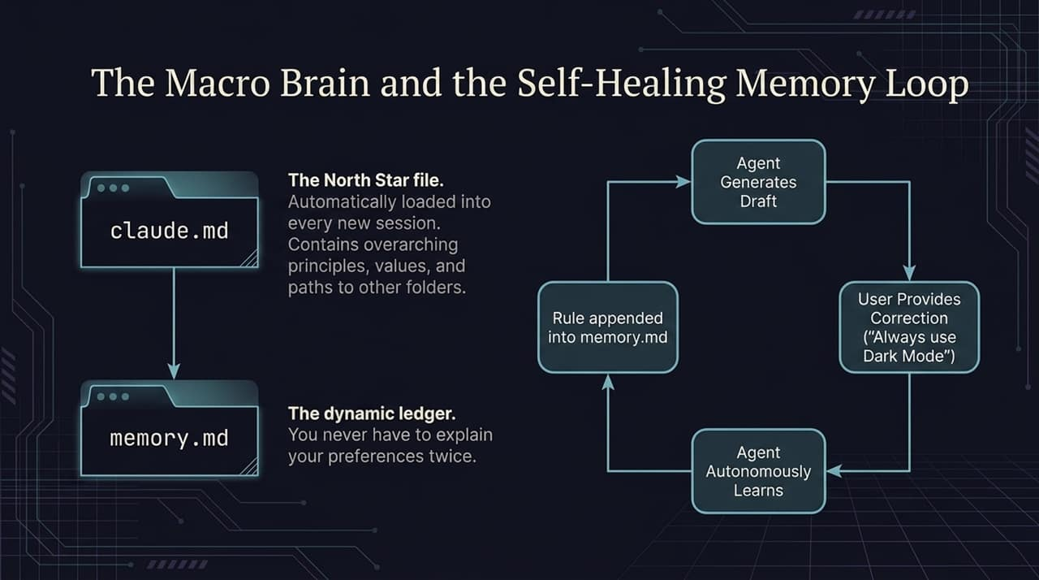
Notes:
To keep your agent aligned across sessions without repeating yourself, you need two fundamental files:
claude.md (or your root configuration file): This is the North Star file. Automatically loaded at the start of every session, it outlines your core principles, global rules, and directory paths.
memory.md: This is your dynamic ledger.
Look at the Self-Healing Memory Loop on this slide. When the agent generates a draft output and you correct it—saying, for example, 'Never use bright blue backgrounds, always use Dark Mode'—the agent doesn't just apply it to that single prompt. It autonomously appends that rule directly into memory.md. The next time a new session starts, that preference is permanently loaded. You never have to explain your preferences twice.

Slide 7
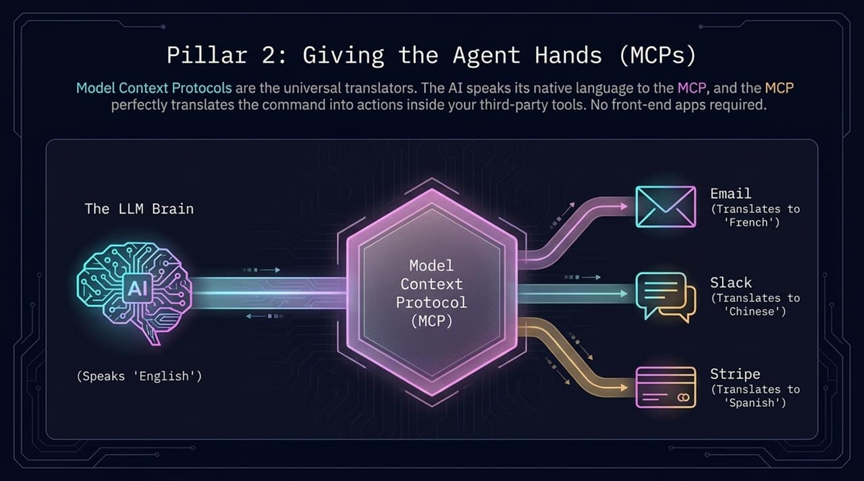
Notes:
Context gives the AI a brain, but Model Context Protocol (MCP) gives the agent hands.
An LLM intrinsically speaks 'natural language'. Software applications like Slack, Gmail, or Stripe speak structured API code. In the past, you needed custom code or complex Zapier webhooks to bridge this gap.
MCP acts as an open-standard universal translator. The AI expresses its intention in natural language to the MCP, and the MCP translates that instruction directly into actions inside third-party applications. The agent can directly query your Stripe account to check yesterday's refunds, send a structured Slack alert, or draft a client email without you touching a single interface.

Slide 8
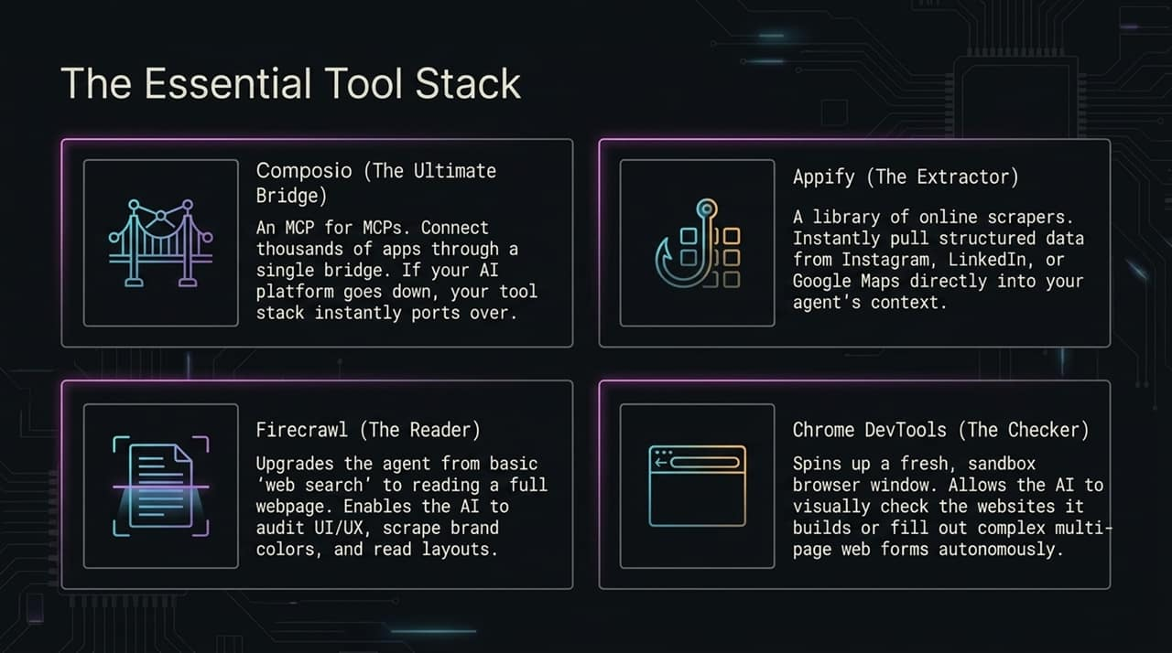
Notes:
To build a high-performing agent, you need a specialized stack of tool connectors:
Composio (The Ultimate Bridge): Think of Composio as an 'MCP for MCPs'. It bridges your AI directly to thousands of apps like Gmail, GitHub, and Notion through a unified authentication layer.
Appify (The Extractor): A specialized collection of scrapers that pull structured data from platforms like LinkedIn, Instagram, or Google Maps directly into your agent's working context.
Firecrawl (The Reader): Upgrades standard search by reading full web pages cleanly in Markdown format. Your agent can audit website UI, read full blog posts, or extract competitor landing page copy.
Chrome DevTools (The Checker): Launches a sandboxed headless browser. The agent can visually inspect web layouts, test buttons, or complete multi-page web forms autonomously.

Slide 9
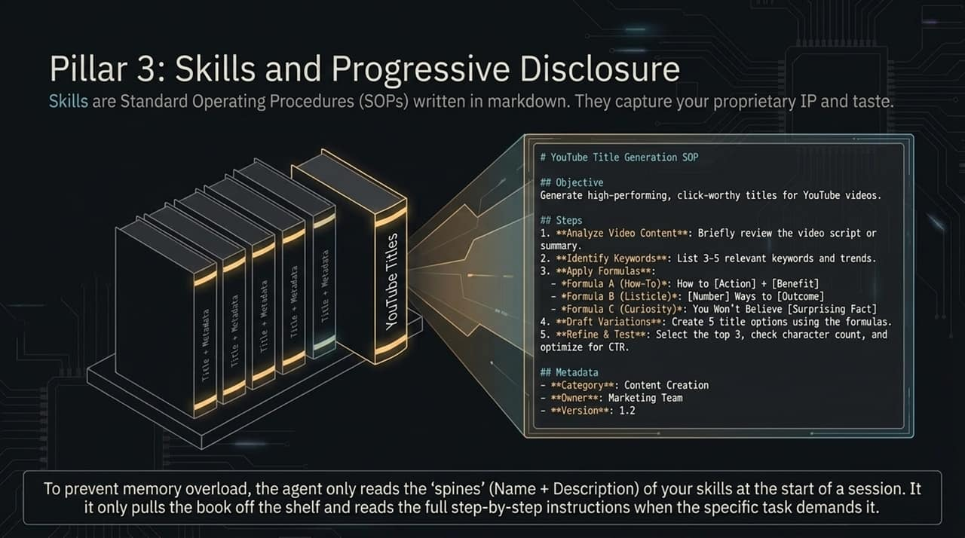
Notes:
Our third pillar is Skills. Skills are your proprietary Standard Operating Procedures (SOPs) written in Markdown. They codify your specific business processes, taste, and standards.
However, if you load 50 detailed SOP files into the context window at once, you’ll trigger context rot. This is where Progressive Disclosure comes in.
Think of a bookshelf. When a session starts, the agent only reads the 'spines' of the books—meaning just the skill name and short description. Only when a specific user request matches that skill description does the agent pull that specific book off the shelf and read the full step-by-step instructions. This keeps context usage lean while maintaining access to dozens of automated workflows.

Slide 10
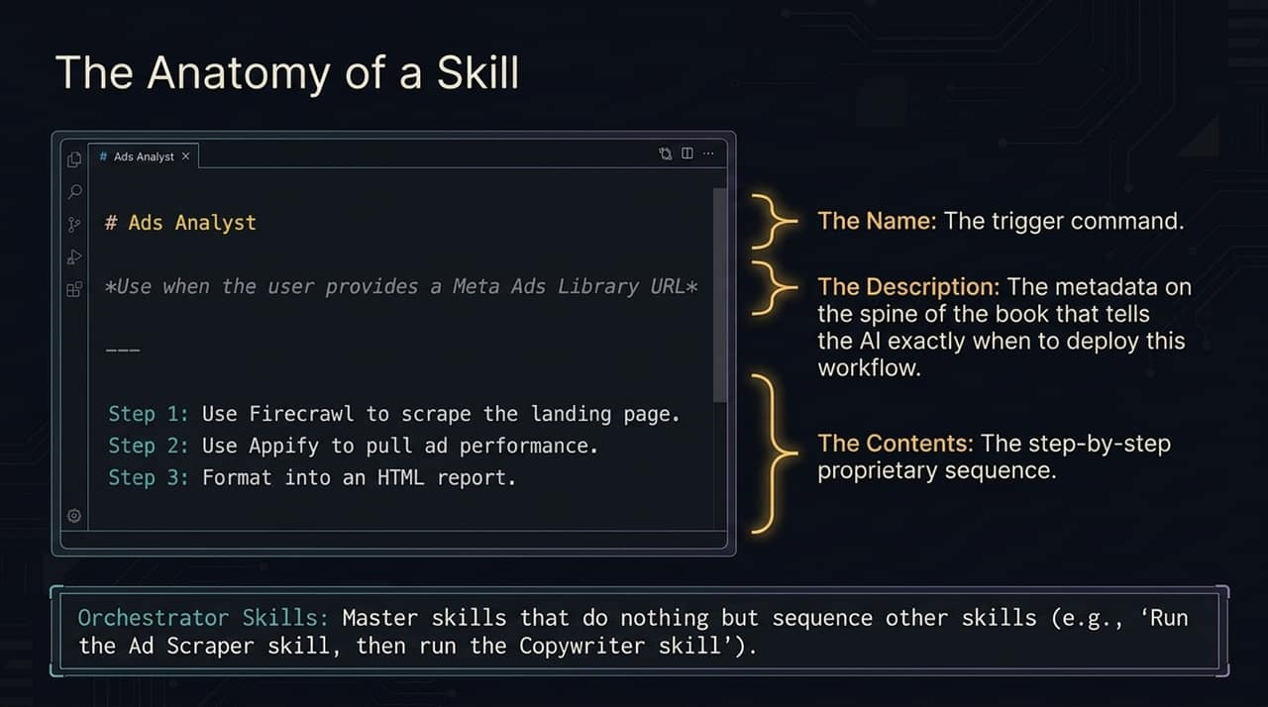
Notes:
Let's break down how a skill file is structured. A well-crafted skill .md file contains three core sections:
The Name: The trigger header (e.g., # Ads Analyst).
The Description: This is the metadata read during startup. For example: *Use when the user provides a Meta Ads Library URL*. This tells the AI when to execute the workflow.
The Contents: The strict, sequential steps the agent must execute. (e.g., Step 1: Scrape page with Firecrawl; Step 2: Extract ad metrics; Step 3: Format HTML report).
You can also create Orchestrator Skills—master skills that control other skills in sequence. For instance, a master skill could instruct the agent: 'First run the Ad Scraper skill, then pass those results into the Copywriter skill'.

Slide 11
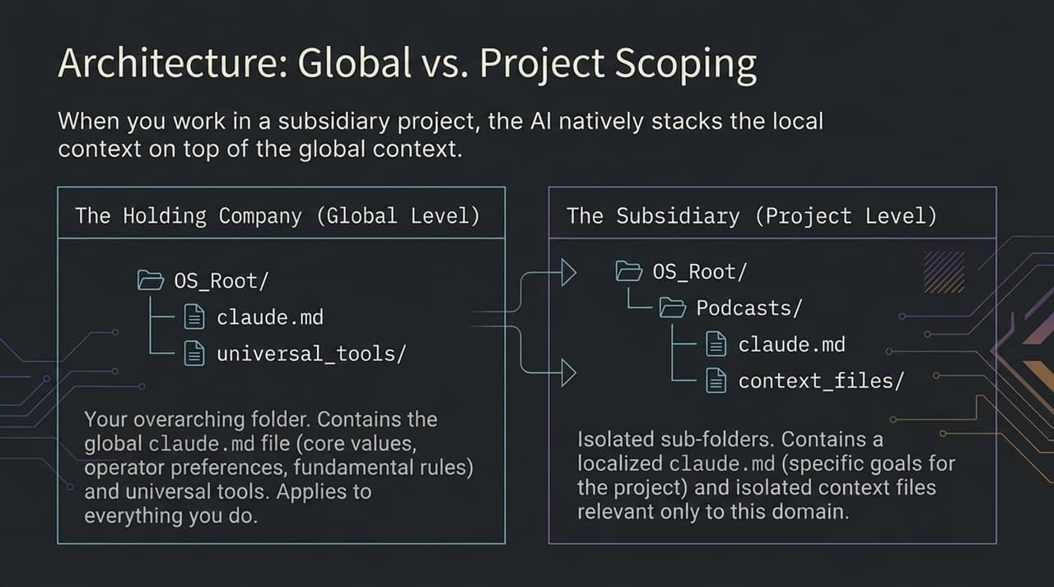
Notes:
As your personal AI OS grows, structure becomes critical. You should organize your file system using a Global vs. Local hierarchy.
Think of this like a Holding Company and its Subsidiaries:
Global Level (OS_Root/): Houses universal preferences, master values, and global tools in a root claude.md file. This context applies to everything you do.
Project Level (OS_Root/Podcasts/): Contains localized claude.md files and context specific only to that venture.
When you work inside a project folder, the AI natively stacks the local project context on top of your global context. This keeps project data completely isolated while preserving your global operator preferences.

Slide 12
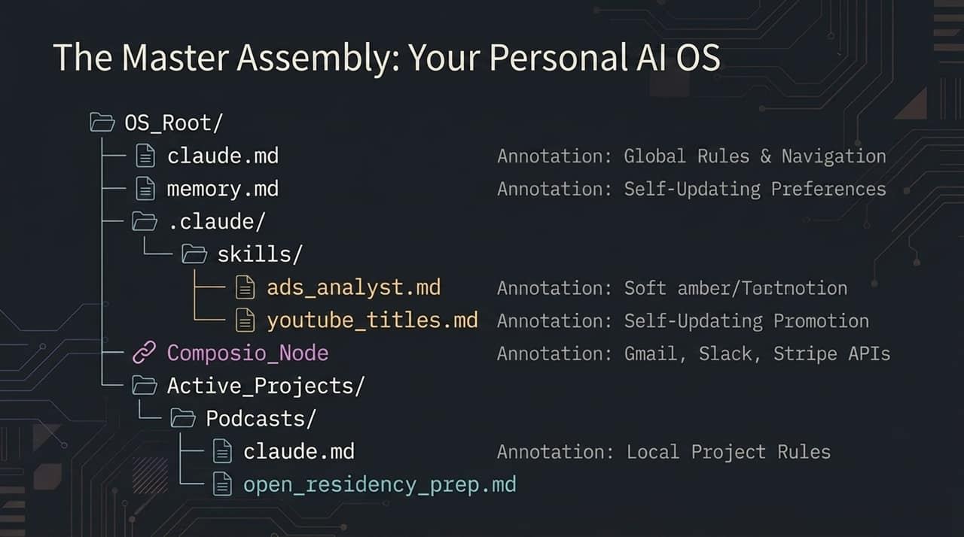
Notes:
Here on Slide 12 is the complete blueprint of your Personal AI Operating System.
At the top level, you have your root directory containing claude.md for overarching rules and memory.md for live updating preferences.
Under .claude/skills/, you store modular workflows like ads_analyst.md and youtube_titles.md. Connectors like Composio bridge the local OS to external APIs like Gmail, Slack, and Stripe. Finally, isolated sub-directories under Active_Projects/ handle individual domain tasks.
Once set up, working with AI is no longer about typing isolated prompts into a web box; it’s about operating within an integrated environment.

Slide 13
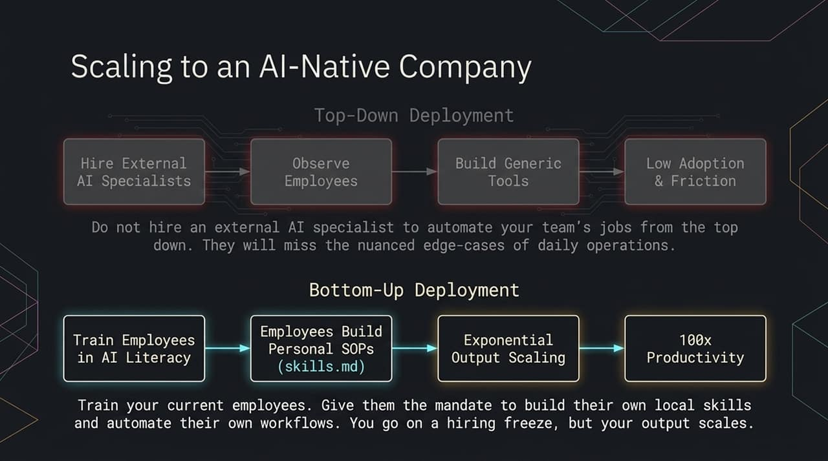
Notes:
If you manage a business or team, pay close attention to this slide. Most organizations fail at AI integration because they use a Top-Down Deployment model. They hire expensive external AI consultants to build rigid, generic tools top-down. These consultants don't know the daily micro-edge cases, leading to low employee adoption and friction.
The winning strategy is Bottom-Up Deployment. Train your current team in basic AI literacy and give them the mandate to build their own local skills (.md SOPs) for their daily workflows.
Your team members know their jobs better than anyone else. When they turn their personal SOPs into AI skills, operational output scales exponentially without requiring headcount expansion.

Slide 14
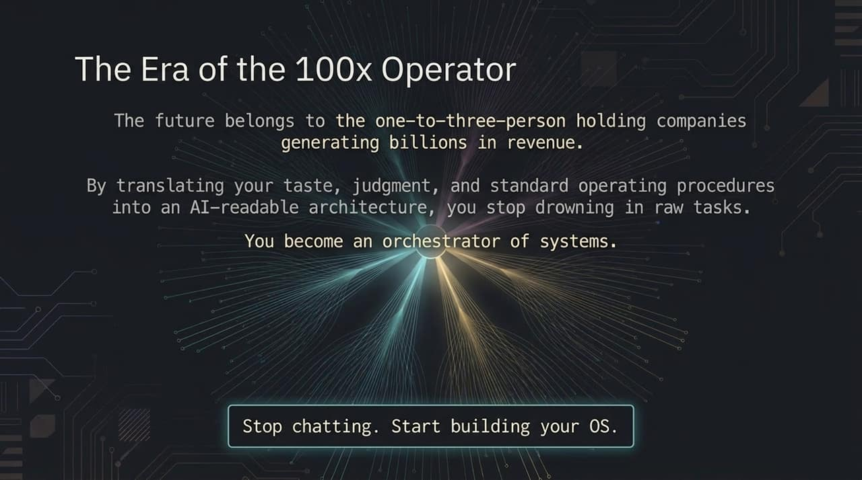
Notes:
We are entering the era of the 100x Operator. We will soon see one-to-three-person holding companies generating tens or hundreds of millions in revenue.
The bottleneck is no longer how many hours you can sit at a keyboard executing manual tasks. The bottleneck is your ability to translate your judgment, taste, and operational standards into an AI-readable architecture.
Stop drowning in execution. Stop spending your day chatting back and forth with AI. Start building your system.
To summarize our journey today:
We move from Stage 1 (Chat)—where we ask simple questions to get answers—to Stage 2 (Agents)—where we assign high-level goals to receive complete executed results.
We drive this transformation through the Observe, Think, Act execution loop, supported by our three onboarding pillars:
Context via Markdown files
Tools via MCP connectors like Composio, Firecrawl, and Appify
Skills via modular SOPs
When you put these pieces together, a single operator can achieve what used to require an entire team, multiplying productivity several times over.

Slide 15
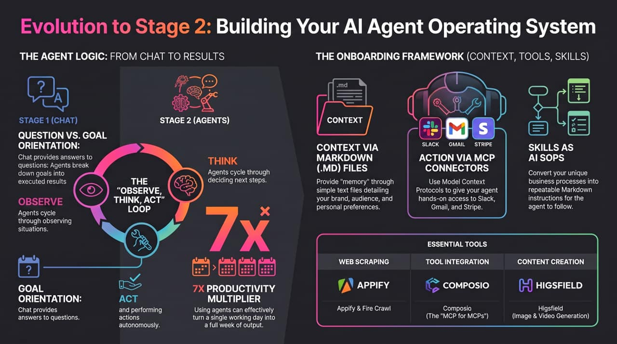
Notes:
Here is your homework to get started today:
Build your context folder: Create a directory with simple .md files defining your core brand voice, target audience, and preferences.
Connect your core tools: Hook up an MCP bridge like Composio to give your agent access to your primary workplace tools (Slack, Email, Drive).
Complete one full workday inside your agent environment: The next time you perform a repetitive task, don't just do it manually. Work alongside your agent and have it compile the process into a permanent .md skill file.
Start small, build your foundational files, and expand your operating system step by step. Thank you!

